Slide 1
Ramsey Numbers and Their Applications

Slide 2
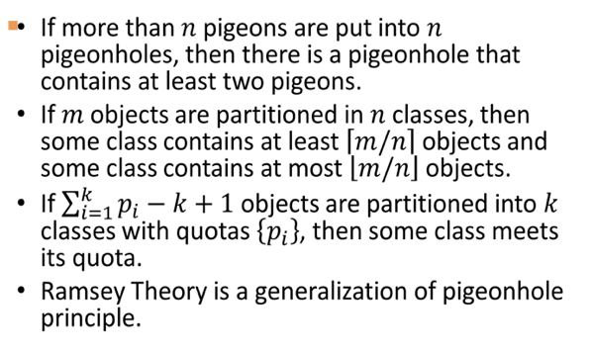
From Pigeonhole Principle to Ramsey Theory
Ramsey Theory is a generalization of Pigeonhole principle.

Slide 3
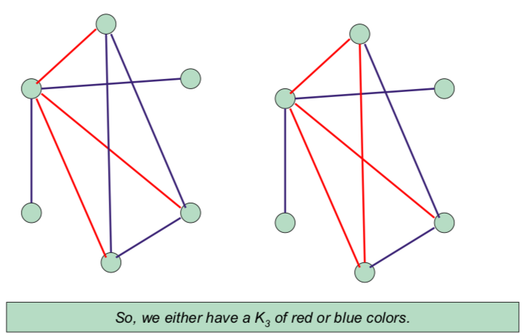
Ramsey Number
The Ramsey number R(m,n)gives the solution to the party problem, which asks the minimum number of guests R(m,n) that must be invited so that at least m will know each other or at least n will not know each other.
R(3,3)=6
Every 2-coloring of the edges of K6 has a monochromatic K3
Challenge 1
Challenge 3

Slide 4
Graph Theory and Ramsey Number
In the language of graph theory, the Ramsey number is the minimum number of vertices v=R(m,n),such that all undirected simple graphs of order v contain a clique of order m or an independent set of order n .
Ramsey theorem states that such a number exists for all m and n.

Slide 5
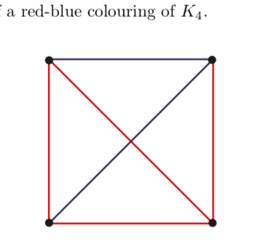
Red Blue Graph Coloring
Given any s, t ∈ N, R(s, t) is the smallest N ∈ N such that every red-blue coloring of the edges of KN contains either a red Ks or a blue Kt
Every 2-coloring of edges of K4 has a monochromatic K2

Slide 6
Some Inequalities
r(m,n)=r(n,m), as you can interchange the colours.
r(2,m)=m
– Either some edge is coloured red (so, K2) or all are coloured blue (so, Km). Thus r(2,m)≤m.
– If we colour all the edges of K_{m-1} blue, we have neither a red K2 nor a blue Km. Thus, r(2,m)>m-1
Prove that a group of 18 people will have atleast 4 mutually known people or 4 mutual strangers.
Compute r(4,4)≤r(3,4)+r(4,3)
r(3,4)≤r(2,4)+r(3,3)=4+6=10
Actually r(3,4)=9
Thus, r(4,4) ≤9+9=18. Hence the result.

Slide 7
Application - Approximation Algorithms
The problem of finding an independent set of maximum size or computing α(G), the independence number of a graph G, is one of the earliest problem shown to be NP-hard.
Boppana and Halldorsson (1992) have a famous polynomial time approximation algorithm, based on Ramsey theory, that finds an independent set of a guaranteed but not necessarily optimal size.
For the independence number problem they obtain the O(n/(log n)²) performance guarantee, where n is the number of vertices in the graph.
The same approximation algorithm can be applied for the equivalent MaxClique problem, i.e. finding the maximum size clique.

Slide 8
Application - Automated Theorem Proving
Hilbert’s decision problem : If there exists an algorithm to decide whether a statement in mathematics is true or not, or an algorithm which would find a proof of any mathematical statement that has a proof.
Turing proved that there is no such algorithm in general.
But, Ramsey’s theorem was actually a lemma to a theorem that shows that in a certain special class of first order logic the statements are decidable.
Interestingly, using an extension of the finite Ramsey theorem, Paris and Harrington gave the first natural statement unprovable in finite set theory. The proof is using techniques of mathematical logic.
In computer science, automated proof theory is a growing field. Some Ramsey theory problems have been solved using computer. Robertson (1999) wrote programs to generate new lower bounds for classical multicolored small Ramsey numbers.

Slide 9
Application - Information Theory
Ramsey theorems have been applied to information theory.
The 1984 survey on applications of Ramsey theory explains in detail how one Ramsey-type theorem can be applied to communication channels.
LetG = (V, E) be a graph corresponding to an information (noisy) channel where V represents the input set, i.e. all possible letters the channel can transmit in one use. In each channel use, a sender transmits an input and a receiver receives an output. The vertices corresponding to two letters are adjacent if and only if both can result in the same output and thus they could be confused.
We could choose an independent set as an unambiguous code alphabet for sending messages. The maximum number of letters that can be transmitted in a single use without error is then the maximum size of an independent set.

Slide 10
Thank - You!
Presenter : Shruti Sharma (192)
Mentor : Prof. Sanjoy Pratihar

